Slide 1

Community Detection and its Application in Interpretation of Genomic Deep Neural Models
Ofir Yaish
Clustering and Unsupervised Learning
Prof. Amir Geva

Slide 2
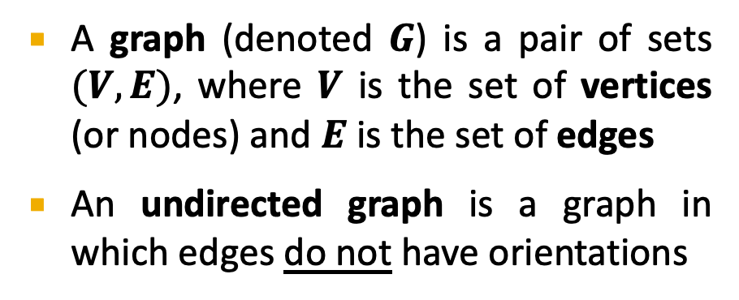
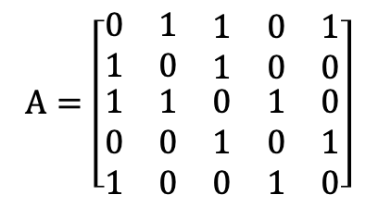


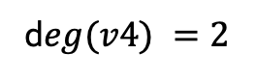

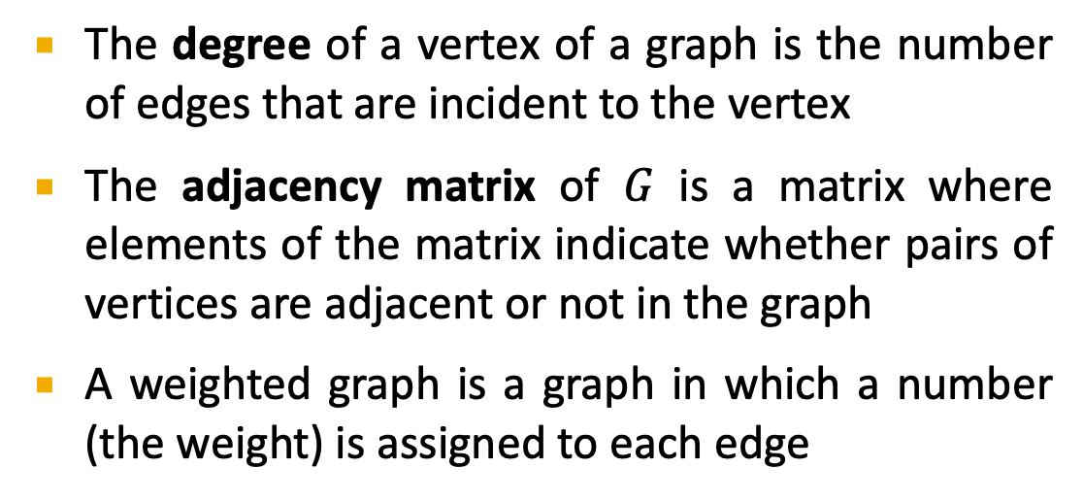

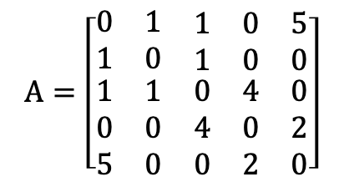
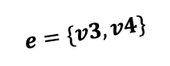
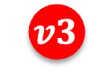
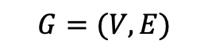
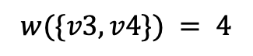
Some Graph Definitions
A graph (denoted $G$) is a pair of sets $(V,E)$, where $V$ is the set of vertices (or nodes) and $E$ is the set of edges
An undirected graph is a graph in which edges do not have orientations
$$G=(V, E)$$
$$v1$$
$$v5$$
1
5
$$v2$$
1
2
4
$$v4$$
1
$$v3$$
$$e=\{v3, v4\}$$
d$eg(v4) =2$
The degree of a vertex of a graph is the number of edges that are incident to the vertex
The adjacency matrix of $G$ is a matrix where elements of the matrix indicate whether pairs of vertices are adjacent or not in the graph
A weighted graph is a graph in which a number (the weight) is assigned to each edge
$$A=\left[\begin{matrix}0 & 1 & \begin{matrix}1 & 0 & 5\end{matrix} \\ 1 & 0 & \begin{matrix}1 & 0 & 0\end{matrix} \\ \begin{matrix}1 \\ 0 \\ 5\end{matrix} & \begin{matrix}1 \\ 0 \\ 0\end{matrix} & \begin{matrix}\begin{matrix}0 \\ 4 \\ 0\end{matrix} & \begin{matrix}4 \\ 0 \\ 2\end{matrix} & \begin{matrix}0 \\ 2 \\ 0\end{matrix}\end{matrix}\end{matrix}\right]$$
$$A=\left[\begin{matrix}0 & 1 & \begin{matrix}1 & 0 & 1\end{matrix} \\ 1 & 0 & \begin{matrix}1 & 0 & 0\end{matrix} \\ \begin{matrix}1 \\ 0 \\ 1\end{matrix} & \begin{matrix}1 \\ 0 \\ 0\end{matrix} & \begin{matrix}\begin{matrix}0 \\ 1 \\ 0\end{matrix} & \begin{matrix}1 \\ 0 \\ 1\end{matrix} & \begin{matrix}0 \\ 1 \\ 0\end{matrix}\end{matrix}\end{matrix}\right]$$
$$w(\{v3, v4\}) = 4$$

Slide 3
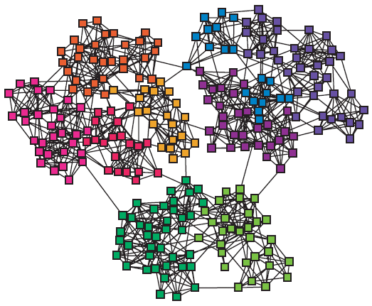
Networks & Communities
A network is a graph that means something, e.g., a Facebook network
We often think of networks being organized into modules, clusters, communities:
Notes:
Many complex systems can be represented as networks, where the elementary parts of a system and their mutual interactions are nodes and links, respectively. Complex systems are usually organized in compartments, which have their own role and/or function. In the network representation, such compartments appear as sets of nodes with a high density of internal links, whereas links between compartments have a comparatively lower desity. Those subgraphs are called communities or modules and occur in a wide variety of networked systems.

Slide 4
Non-overlapping Communities
We will assume that our communities are non-overlapping:
Nodes
Nodes
Network
Adjacency matrix

Slide 5
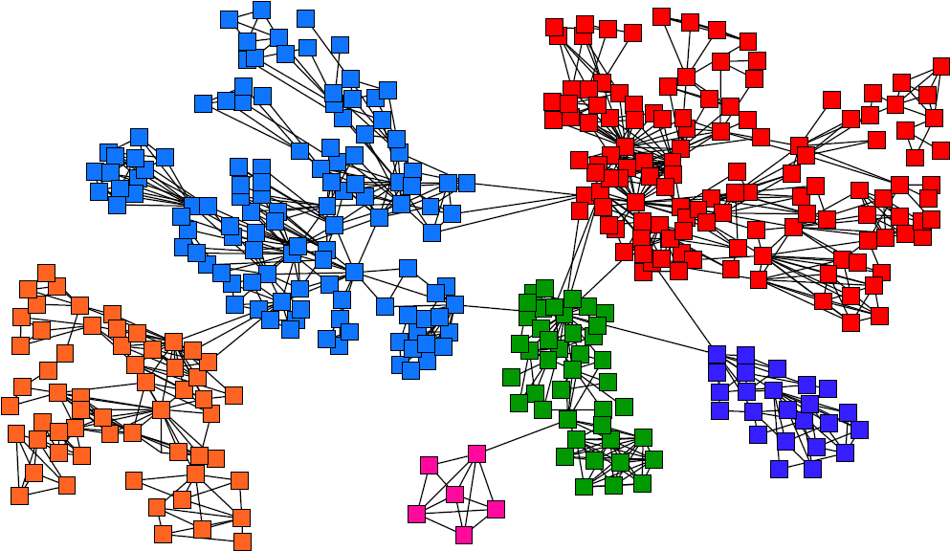
Goal: Find Densely Linked Clusters
Communities appear as sets of nodes with a high density of internal links, whereas links between communities have a comparatively lower desity
physics
Mathematics
Strong ties/edges
Computer science
Weak ties/edges
Physical chemistry
Biochemistry
Organic chemistry
An example of a small co-authorship network depicting collaborations among scientists
Subcommunities correspond roughly to topics of research
Notes:
Finding compartment may shed light on organization of comlex systems and on their function

Slide 6
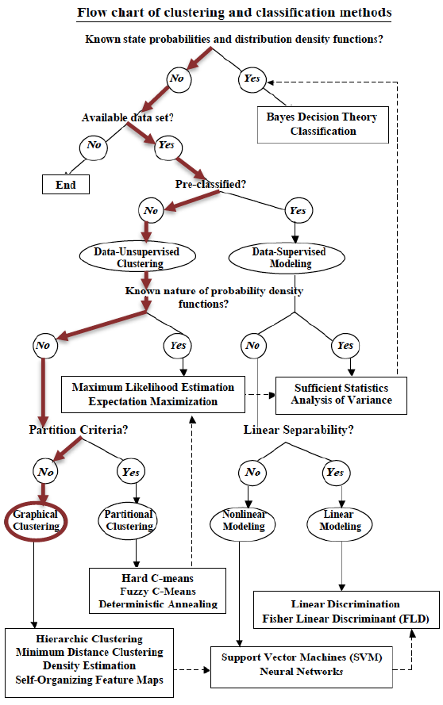

Slide 7
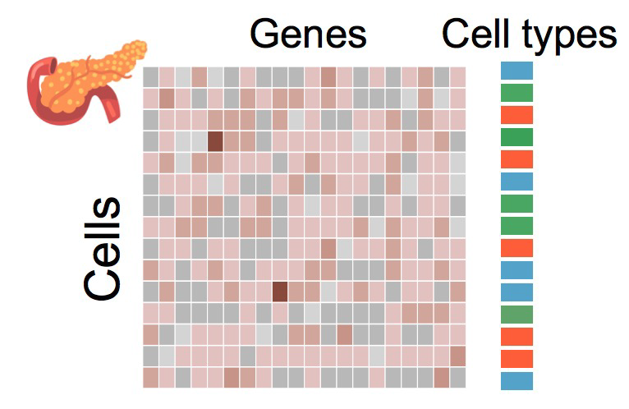
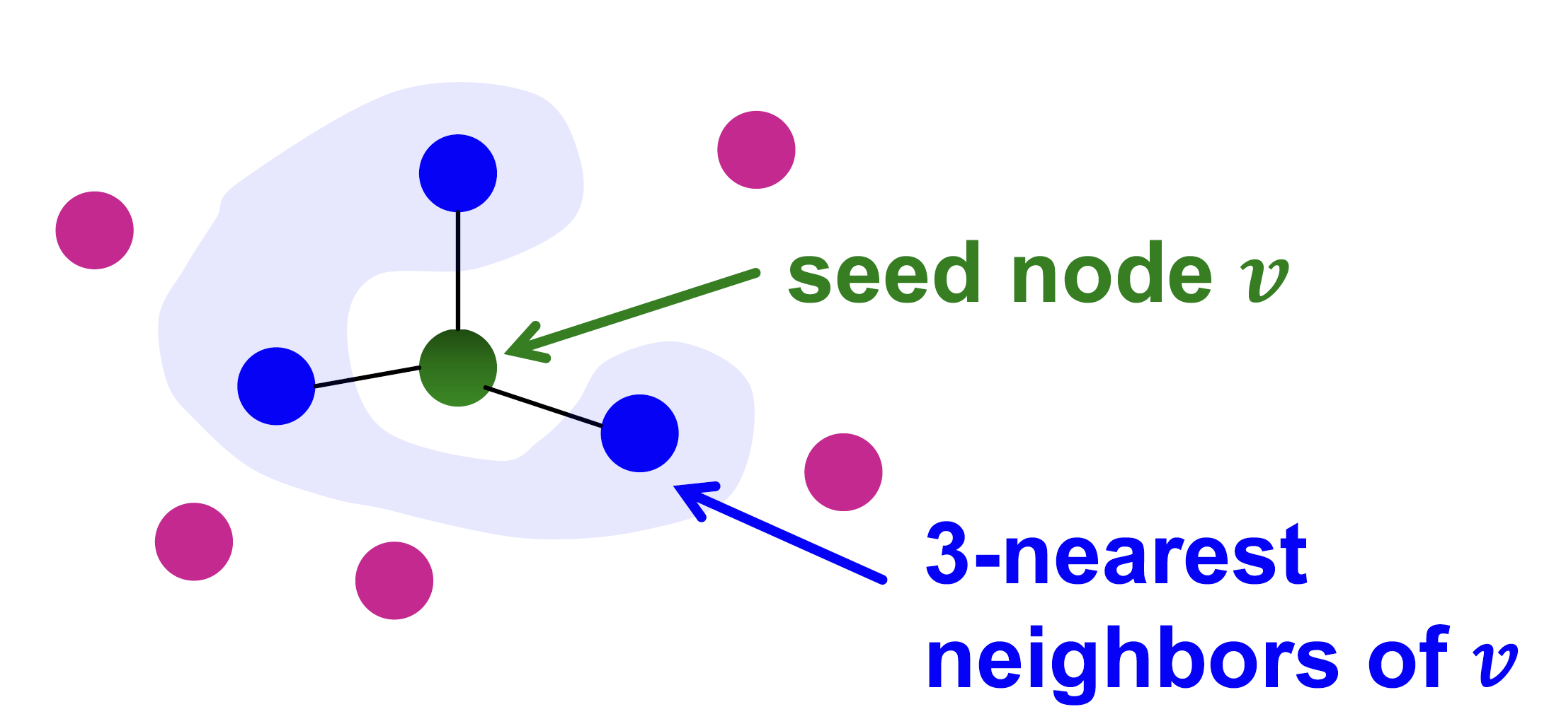
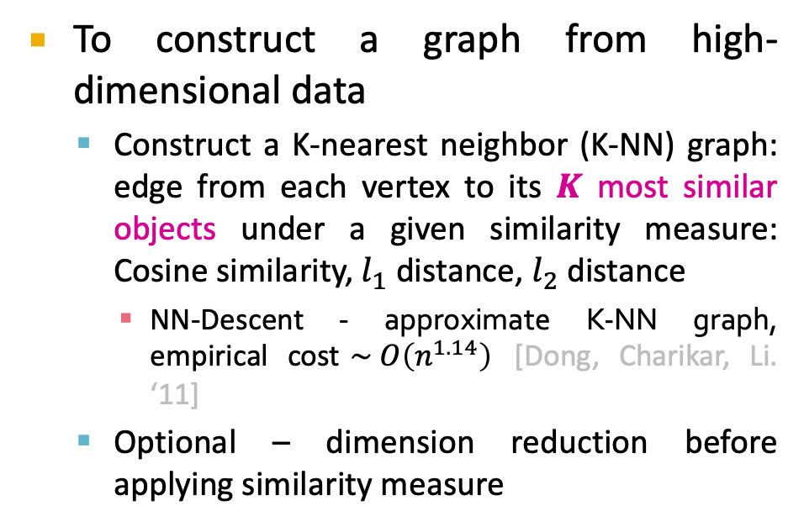
Represent Complex Systems as Graphs
High-dimensional data can be represented as graph
Cell type identification task: Given gene expressions of cells, assign cells to cell types
Understanding the roles of cells
Gene expressions
(~20k genes)
To construct a graph from high-dimensional data
Construct a K-nearest neighbor (K-NN) graph: edge from each vertex to its 𝑲 most similar objects under a given similarity measure: Cosine similarity, $l_{1}$ distance, $l_{2}$ distance
NN-Descent - approximate K-NN graph, empirical cost$\sim O\left(n^{1.14}\right)$ [Dong, Charikar, Li. ‘11]
Optional – dimension reduction before applying similarity measure
1k-1m data-points
Notes:
NN-Descent - Idea: a neighbor of a neighbor is also likely to be a neighbor

Slide 8
Challenges with Standard Clusring
Can we use standard clustering methods as K-means to solve this problem?
Number of clusters is unknown
K-means does not scale with the number of dimensions and data size
Data can be sparse (most values will be zero)
Clustering outliers
In practice - Reduced performance such tasks

Slide 9
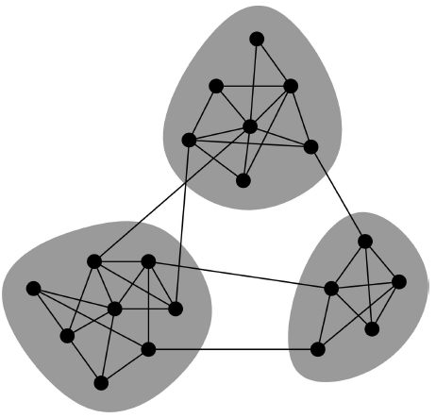
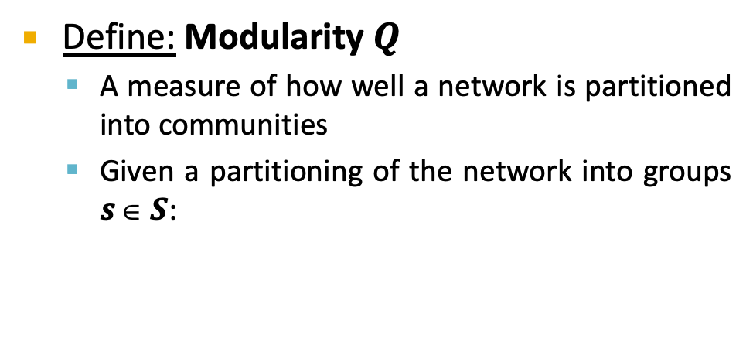
Network Communities
There are various approaches to tackling the community detection problem
We will introduce one based on modularity maximization
Define: Modularity $Q$
A measure of how well a network is partitioned into communities
Given a partitioning of the network into groups $s  S$:
Q ∝ ∑_{s∈ S} [ (# edges within group s) – (expected # edges within group s) ]
Need a null model!
[Newman, PNAS, 2006]

Slide 10
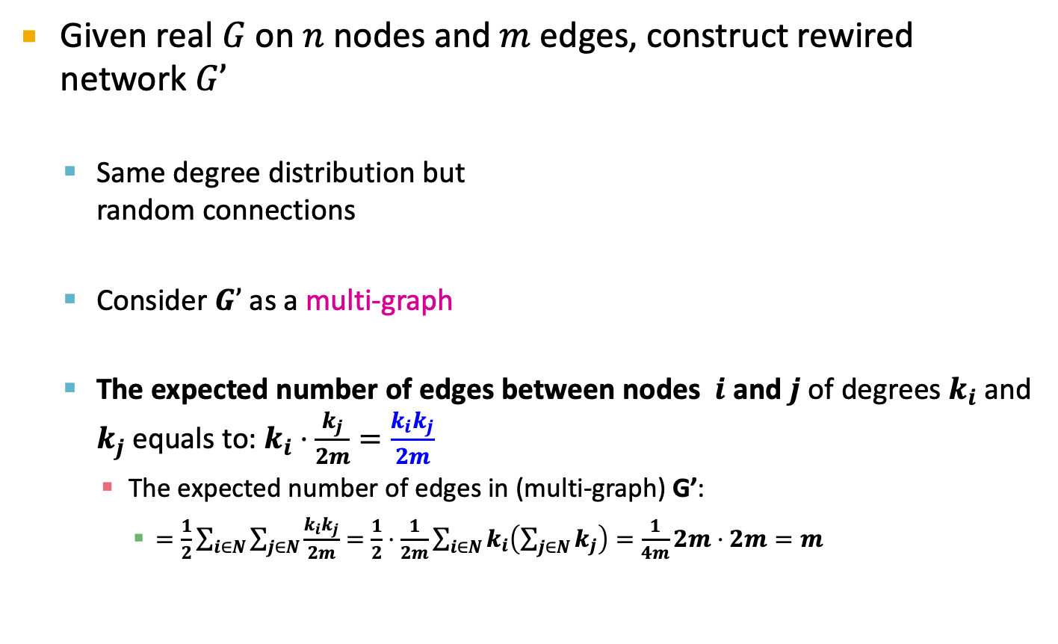
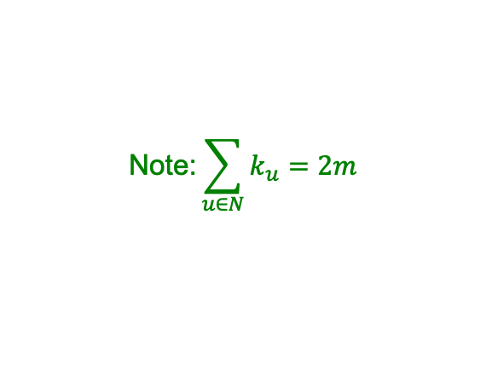
Null Model: Configuration Model
Given real $G$ on $n$ nodes and $m$ edges, construct rewired network $G’$
Same degree distribution but random connections
Consider $G’$ as a multi-graph
The expected number of edges between nodes $i$ and $j$ of degrees $k_{i}$and $k_{j}$ equals to: $k_{i}⋅\frac{k_{j}}{2m}=\frac{k_{i}k_{j}}{2m}$
The expected number of edges in (multi-graph) G’:
$=\frac{1}{2}\sum_{i∈N}{\sum_{j∈N}{\frac{k_{i}k_{j}}{2m}}}=\frac{1}{2}⋅\frac{1}{2m}\sum_{i∈N}{k_{i}\left(\sum_{j∈N}{k_{j}}\right)}=\frac{1}{4m}2m⋅2m=m$
i
j
$$\text{Note}\text{:}\sum_{u∈N}{k_{u}}=2m$$

Slide 11
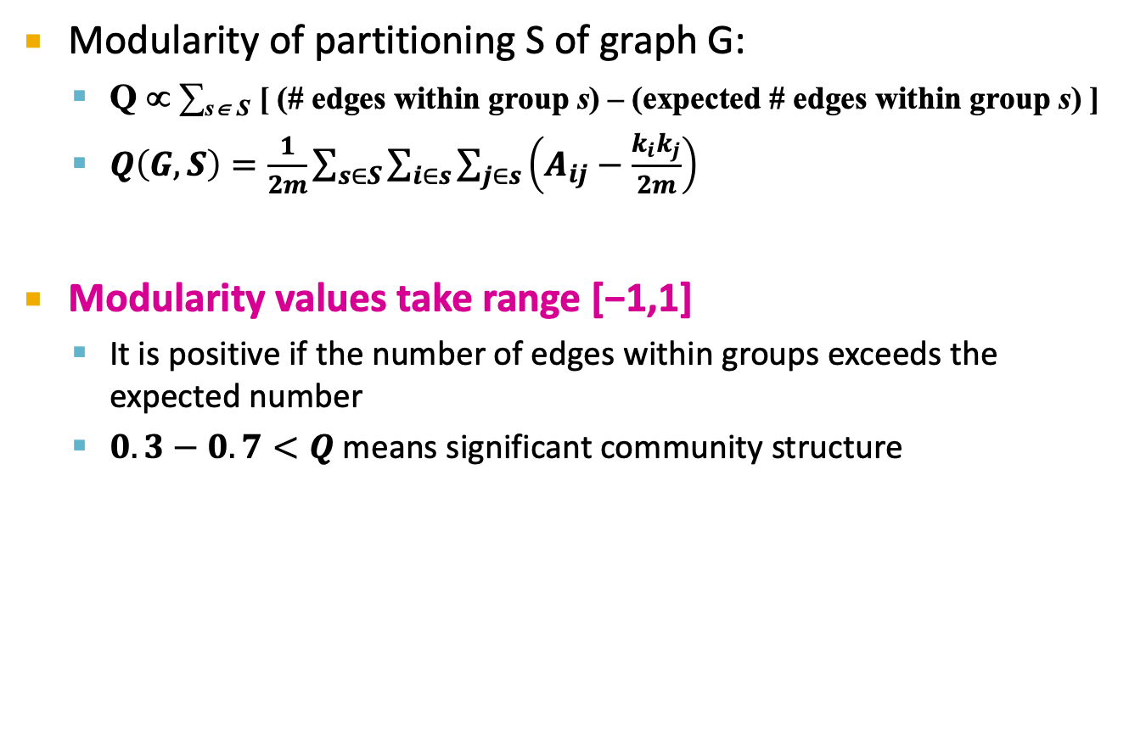
Modularity
Modularity of partitioning S of graph G:
Q ∝ ∑_{s∈ S} [ (# edges within group s) – (expected # edges within group s) ]
$Q\left(G,S\right)=\frac{1}{2m}\sum_{s∈S}{\sum_{i∈s}{\sum_{j∈s}{\left(A_{ij}−\frac{k_{i}k_{j}}{2m}\right)}}}$
Modularity values take range [−1,1]
It is positive if the number of edges within groups exceeds the expected number
$0.3−0.7<Q$means significant community structure
Normalizing cost.
Idea: We can identify communities by
maximizing modularity

Slide 12
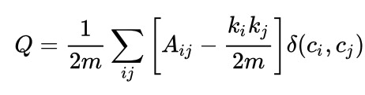
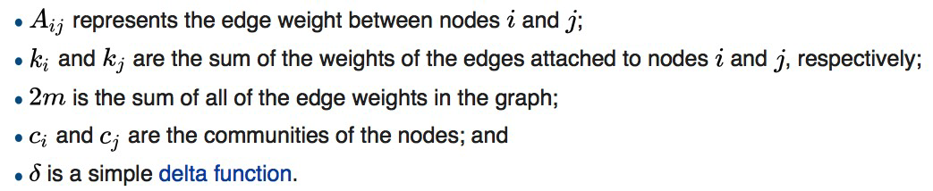
Modularity
Equivalently modularity can be written as:

Slide 13
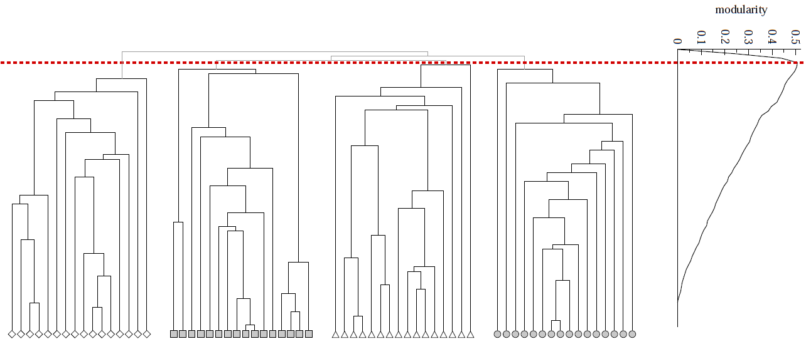
Modularity: Number of clusters
Modularity is useful for selecting the number of clusters:
Q

Slide 14
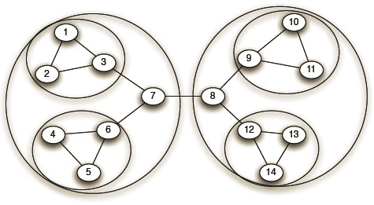
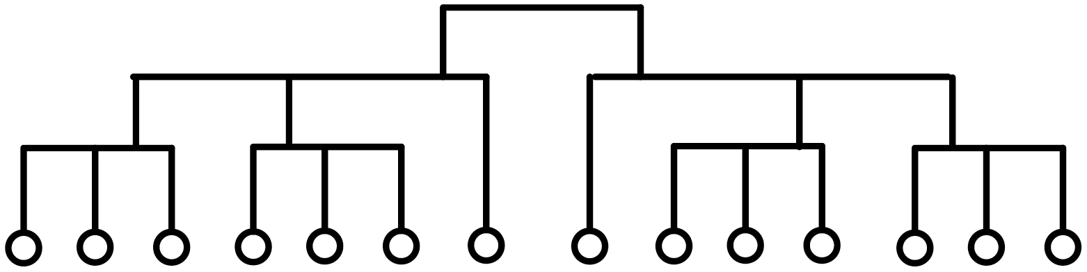
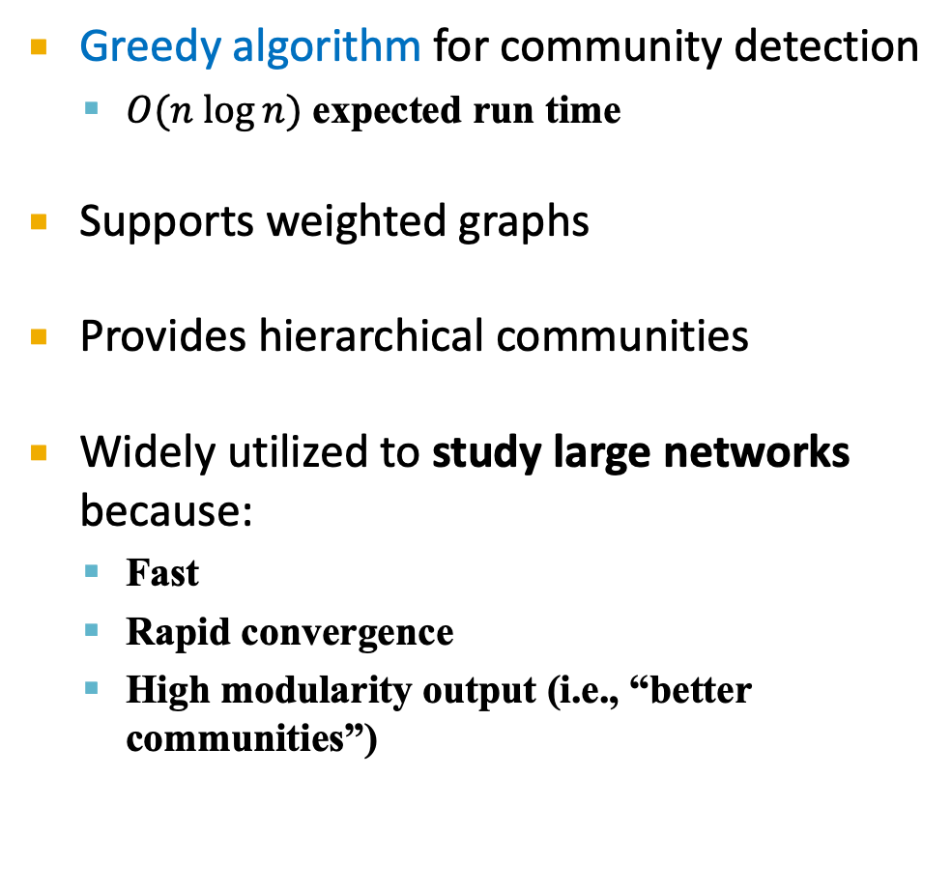
Louvain Algorithm
Greedy algorithm for community detection
$O(n log⁡n)$ expected run time
Supports weighted graphs
Provides hierarchical communities
Widely utilized to study large networks because:
Fast
Rapid convergence
High modularity output (i.e., “better communities”)
Network and communities:
Dendrogram:
Fast unfolding of communities in large networks” Blondel et al. (2008)

Slide 15
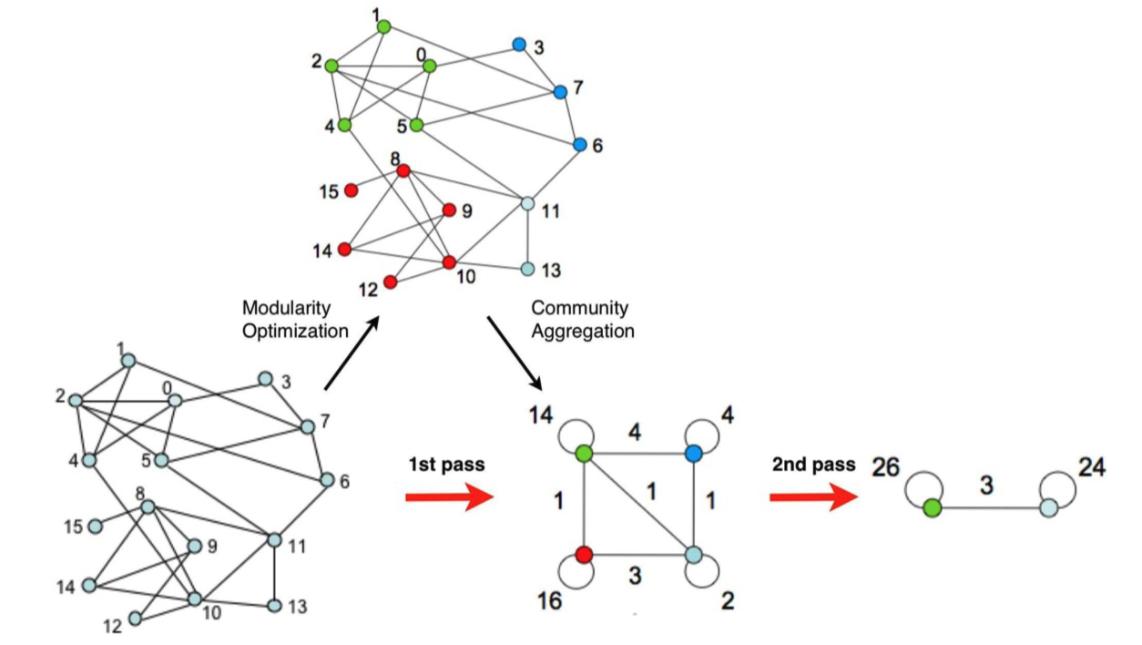
Louvain Algorithm: At High Level
Louvain algorithm greedily maximizes modularity
Each pass is made of 2 phases:
Phase 1: Modularity is optimized by allowing only local changes to node-communities memberships
Phase 2: The identified communities are aggregated into super-nodes to build a new network
Goto Phase 1
The passes are repeated iteratively until no increase of modularity is possible

Slide 16
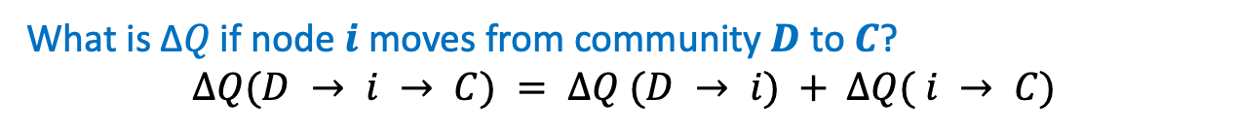
Louvain: 1st phase (partitioning)
Put each node in a graph into a distinct community (one node per community)
For each node 𝑖, the algorithm performs two calculations:
Compute the modularity delta (Δ𝑄) when putting node 𝑖 into the community of some neighbor 𝑗
Move 𝑖 to a community of node 𝑗 that yields the largest gain in Δ𝑄
Phase 1 runs until no movement yields a gain
What is Δ𝑄 if node 𝒊 moves from community 𝑫 to 𝑪?
$$ΔQ(D → i → C) = ΔQ (D → i) + ΔQ( i → C)$$
Notes:
This first phase stops when a local maxima of the modularity is attained, i.e., when no individual node move can improve the modularity.
Note that the output of the algorithm depends on the order in which the nodes are considered.
Research indicates that the ordering of the nodes does not have a significant influence on the overall modularity that is obtained.

Slide 17
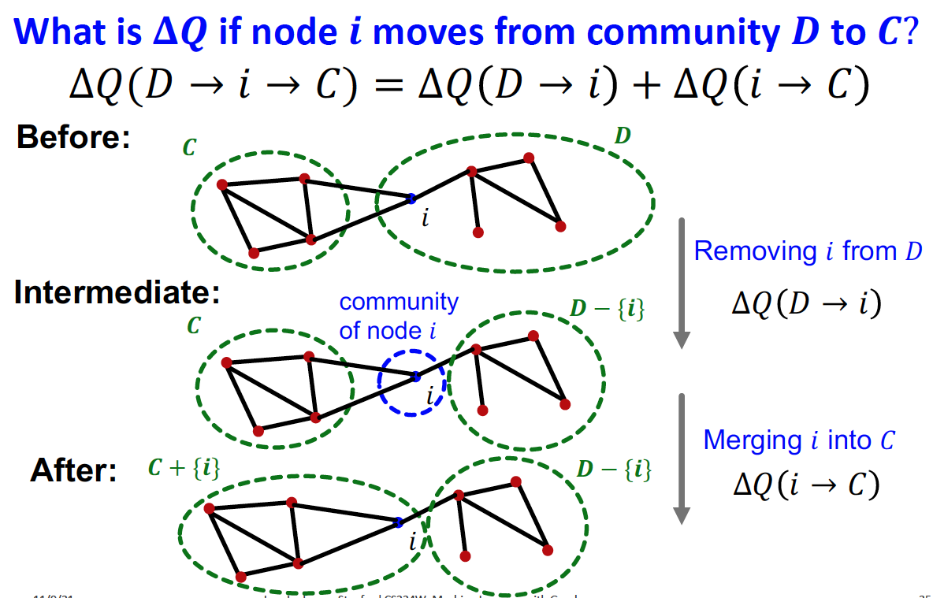
Louvain: Modularity Gain

Slide 18
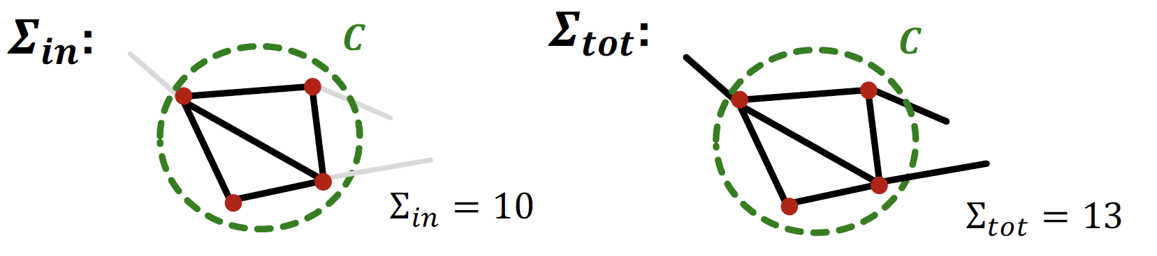
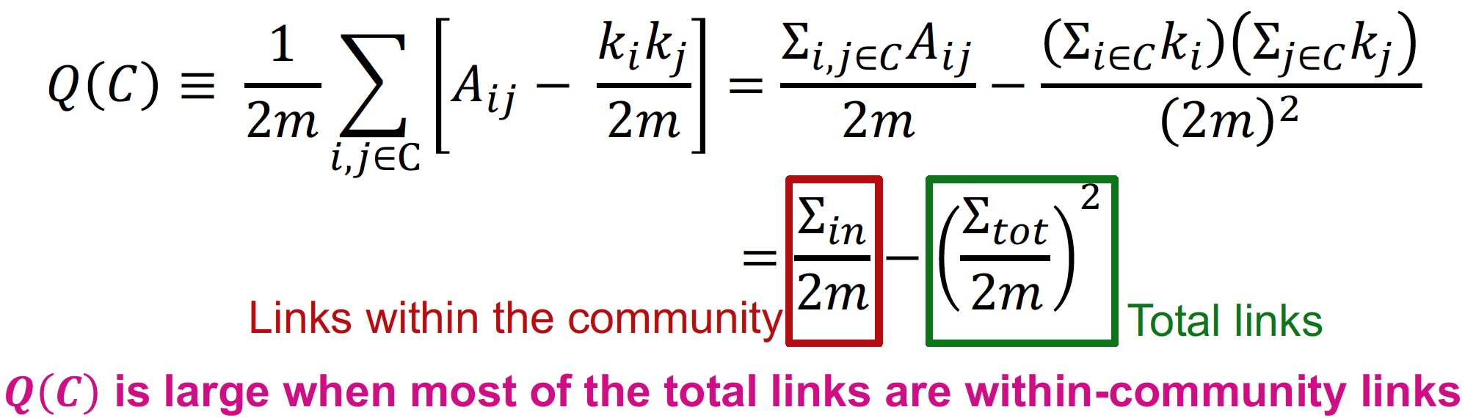
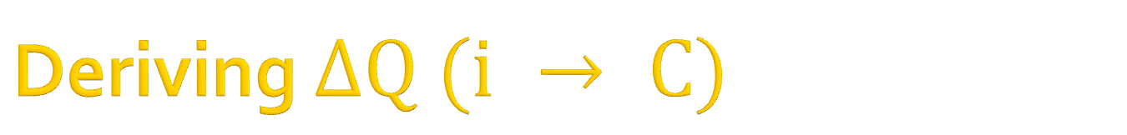
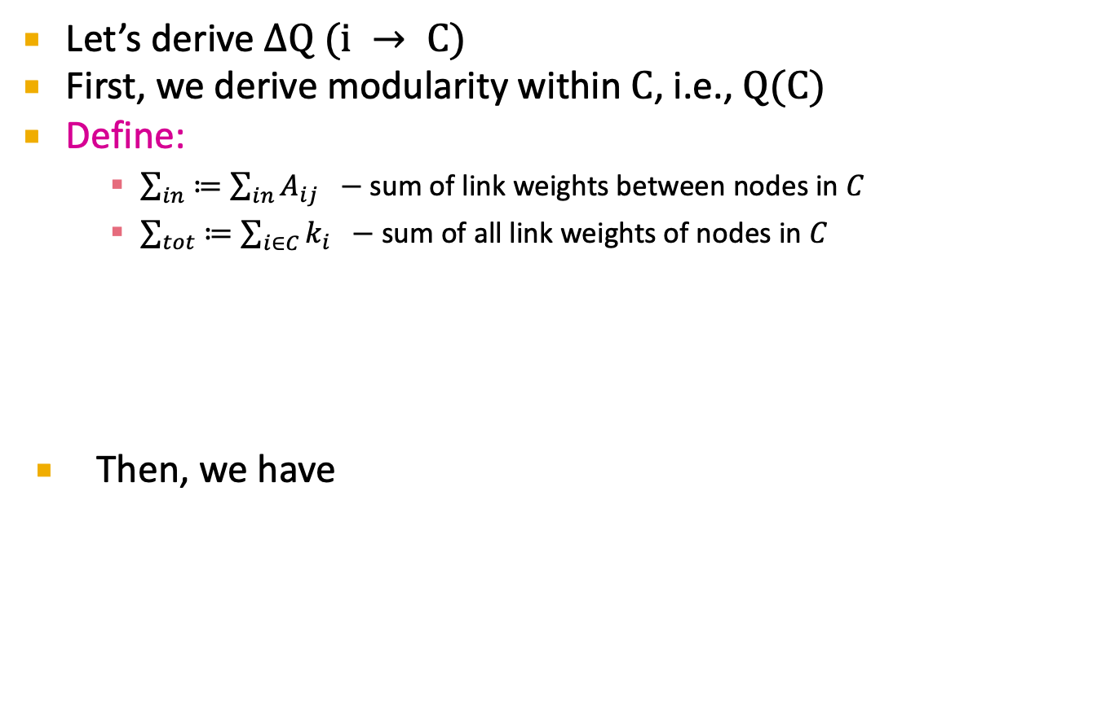
Deriving $ΔQ (i → C)$
Let’s derive $ΔQ (i → C)$
First, we derive modularity within $C$, i.e., $Q(C)$
Define:
$\sum_{in}{≔\sum_{in}{A_{ij} } }−$ sum of link weights between nodes in $C$
$\sum_{tot}{≔\sum_{i∈C}{k_{i} } }−$sum of all link weights of nodes in $C$
Then, we have

Slide 19
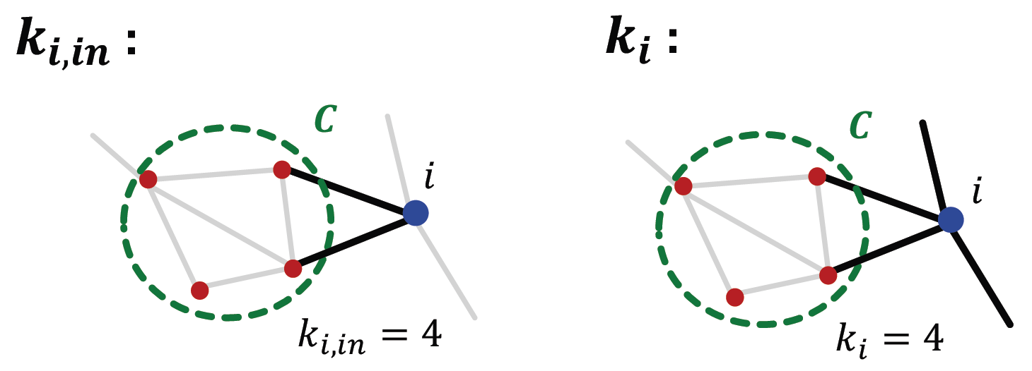
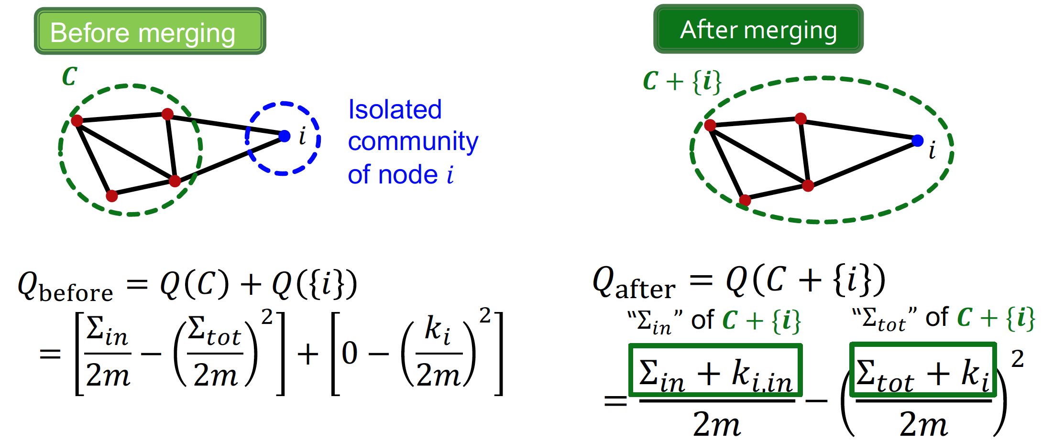
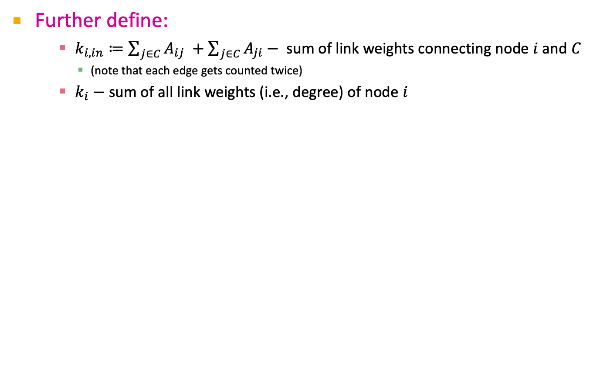
Deriving $ΔQ (i → C)$
Further define:
$k_{i, in}≔\sum_{j∈C}{A_{ij} }+\sum_{j∈C}{A_{ji}− }$ sum of link weights connecting node $i$ and $C$
(note that each edge gets counted twice)
$k_{i}−$sum of all link weights (i.e., degree) of node $i$

Slide 20
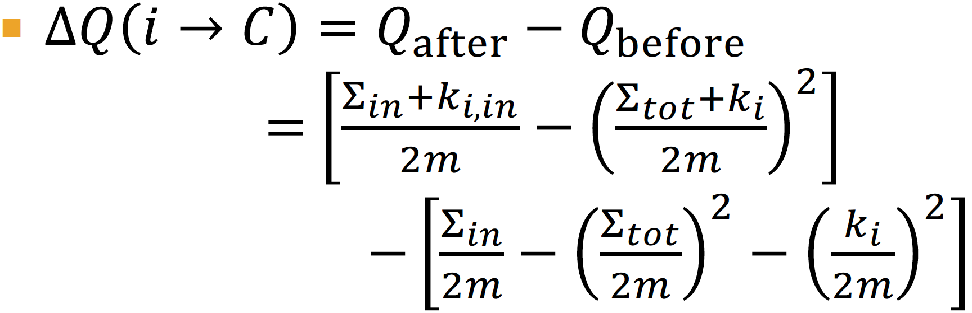
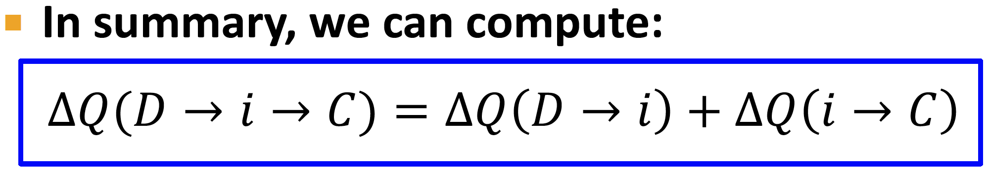
Louvain: Modularity Gain

Slide 21
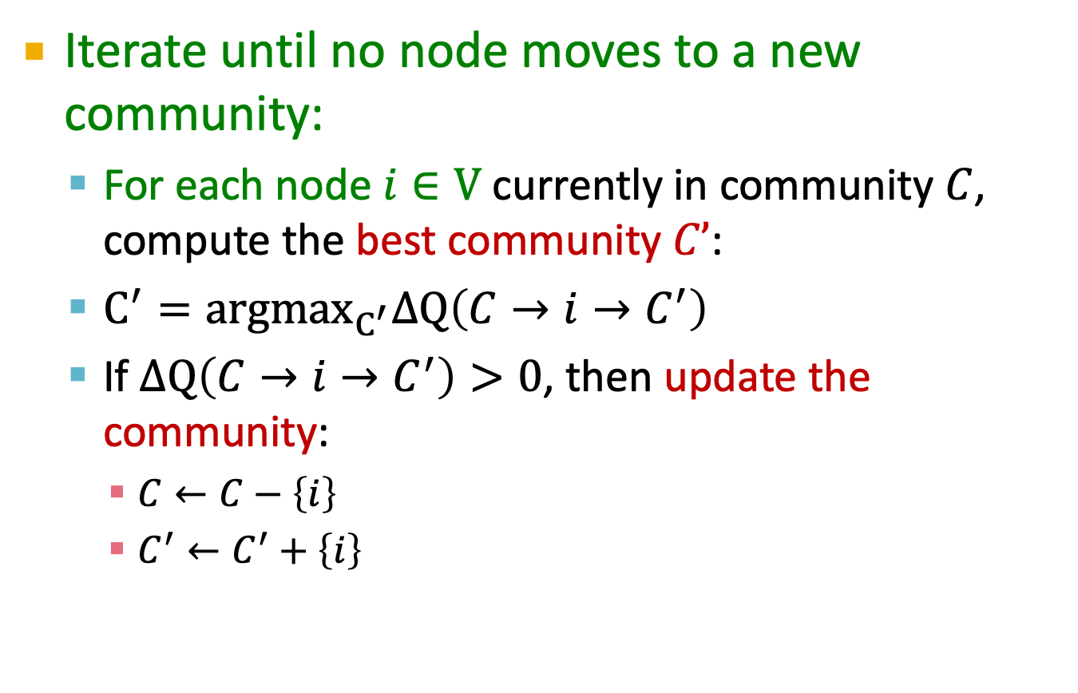
Louvain 1st phase: Summary
Iterate until no node moves to a new community:
For each node $i∈V$ currently in community $C$, compute the best community $C’$:
$C^{′}=argmax_{C^{′}}ΔQ\left(C→i→C^{′}\right)$
If $ΔQ\left(C→i→C^{′}\right)>0$, then update the community:
$C←C−\left\{i\right\}$
$C^{′}←C^{′}+\left\{i\right\}$

Slide 22
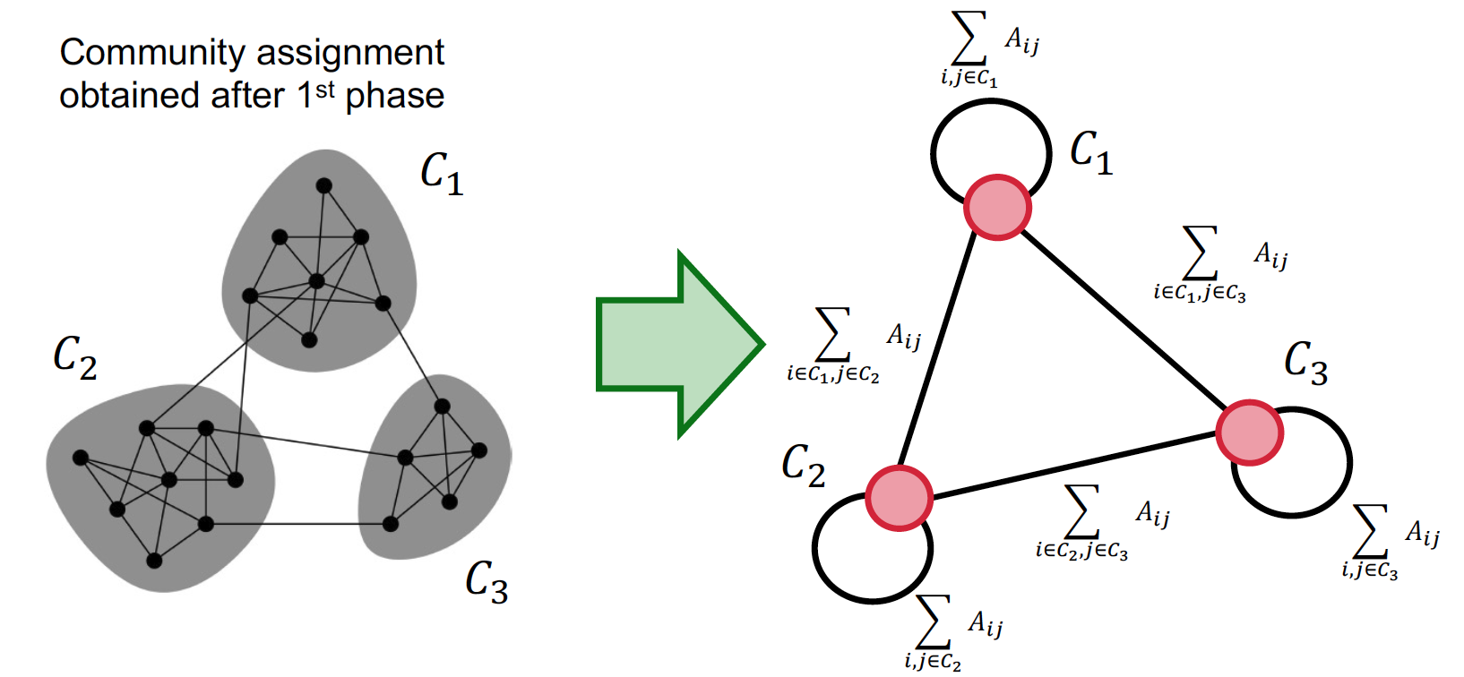
Louvain: 2nd phase (Restructuring)
The communities obtained in the first phase are contracted into super-nodes, and the network is created accordingly:
Super-nodes are connected if there is at least one edge between the nodes of the corresponding communities
The weight of the edge between the two super-nodes is the sum of the weights from all edges between their corresponding communities
Phase 1 is then run on the super-node network

Slide 23
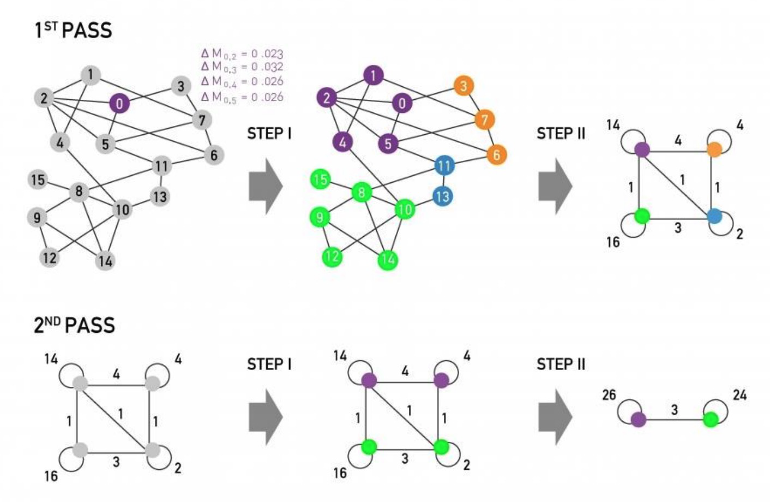
Louvain Algorithm

Slide 24
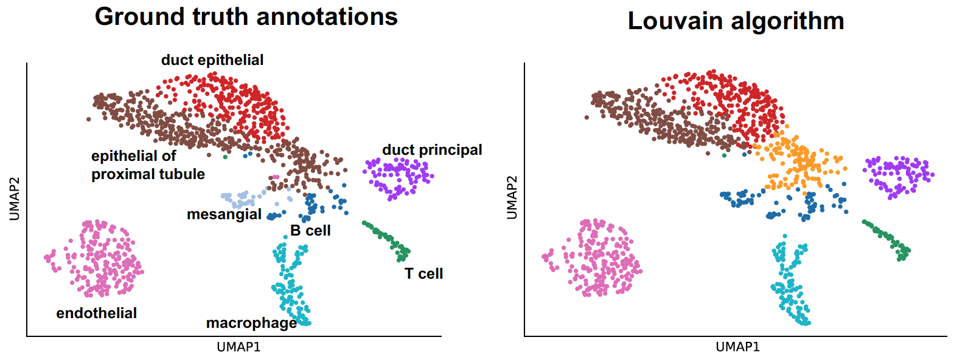
Back to Detecting Cell Types
Input:
Single-cell gene expression data
Steps:
Apply PCA to cell gene expression data (~50 dim)
Create K-NN (K=15) graph between the low-dim cell gene expressions
Apply the Louvain algorithm to identify the clusters

Slide 25
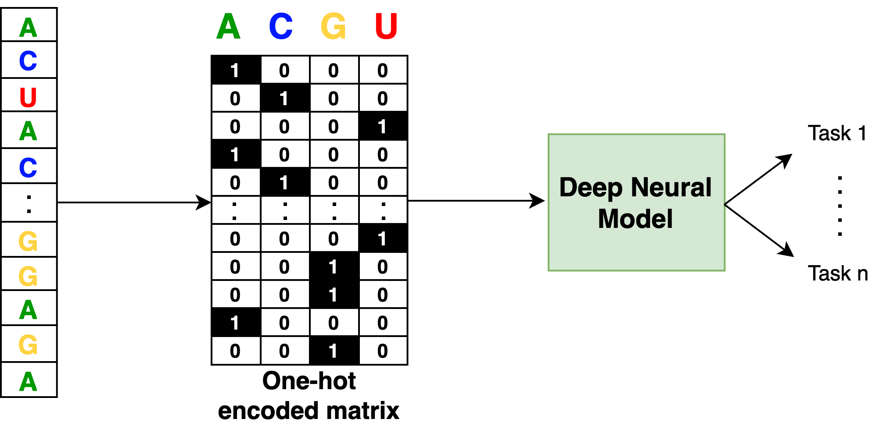
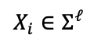
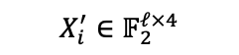
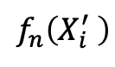
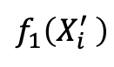
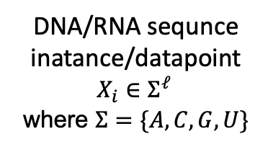
Interpretation of Genomic Deep Neural Models
A general setting of a supervised genomic deep neural model can be represented in a straightforward scheme:
$$f_{1}\left(X_{i}^{′} \right)$$
DNA/RNA sequnce
inatance/datapoint
$$X_{i}∈Σ^{ℓ }$$
where $Σ=\{A,C,G,U\}$
Classifiction or regression tasks
$$X_{i}∈Σ^{ℓ }$$
$$X_{i}^{′}∈𝔽_{2}^{ℓ×4}$$
$$f_{n}\left(X_{i}^{′} \right)$$
Having an accurate predictor is only one requirement
What did the network learn? Why did it make the decisions it made?

Slide 26
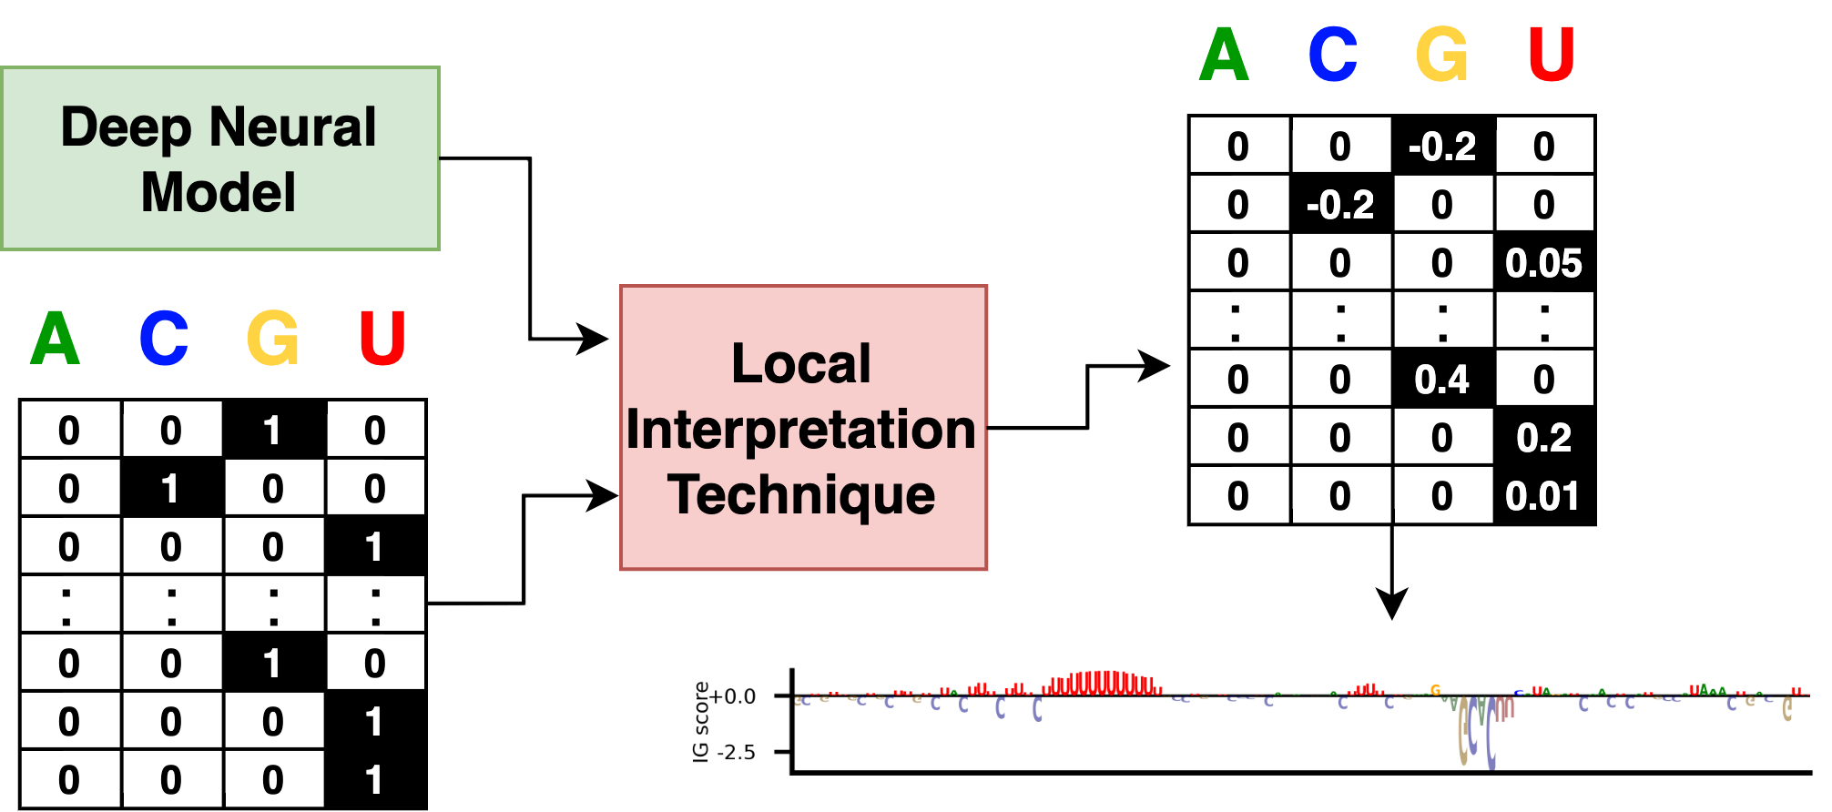
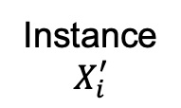
Local and Global Model Interpretation
Local interpretation techniques try to answer the question:
Why did the model make a certain prediction for an instance?
Various techniques have been developed to assign local importance to the input features of an instance. For example, Integrated gradients (IG) which is based on the outputs’ gradients [Sundararajan et al. ICML 2017]
Attribution map
Instance
$$X_{i}^{′}$$
Attributionmap logo
Global interpretation techniques try to answer the question:
how a model behaves in general? What features drive predictions?

Slide 27

Finding Motifs in Attribution Maps
The problem is that local interpretation techniques are applied to one sequence
What are the common patters of the attribution maps?
Transcription Factor Motif Discovery from Importance Scores TF-MoDISco [Shirkumar et al. MLCB NIPS 2018]

Slide 28
Finding Motifs in Attribution Maps
What are the common patters in this example?
TF-MoDISco provides a scalable technique based on clustering for finding motifs in attribution maps

Slide 29
TF-MoDISco phases
The method is comparised of 3 phases:
Create metaclusters – cluster segments of the input, termed “seqlets”, into metaclusters so that each has a distinct pattern of contribution to the various tasks. Almost sequence content-independent
Cluster within a metacluster - subcluster the seqlets in a metacluster. Seqnance content and importance -dependent
Post-processing of clusters – Make sure that two motifs were not merged (we will skip this)
Input to TF-MoDISco: Attribution score maps
As a case study, we examine a predictive model with 3 tasks
Notes:
And hypothetical importance scores. A hypothetical importance score answers the question “if I were to mutate the sequence at a particular position to a different letter, what would the importance on the newly-introduced letter look like?”

Slide 30

TF-MoDISco: 1st phase
(1) Compute per-task importance score

Slide 31
TF-MoDISco: 1st phase
(2) Segment to “seqlets” of high importance in at least one task
Seqlet importance is the sum of its scores, computed in sliding-window.
The threshold for high importance is determined by a null distribution (characterize noise).
A desired false-discovery rate is calculated by isotonic regression.

Slide 32

TF-MoDISco: 1st phase
Positive Threshold for filtering out
isotonic regression for the positive window scores
Finally, an additional filter and union stage is done according to seqlets overlapping

Slide 33




TF-MoDISco: 1st phase
(3) Prepare seqlet vector of scores per task
seqlet scores vector
seqlet scores vector
$$\left[\begin{matrix}\begin{aligned}1.4 \\ \end{aligned} \\ \begin{aligned}1.3 \\ \end{aligned} \\ 1.2\end{matrix}\right]$$
$$\left[\begin{matrix}\begin{aligned}0.2 \\ \end{aligned} \\ \begin{aligned}4.3 \\ \end{aligned} \\ 3.1\end{matrix}\right]$$
To make scores of different tasks comparable - normalize scores per task, i.e., for each task score, assign its percentile in the absolute scores' distribution
Notes:
(multiply percentile of negative scores by -1, therefore, results from -1 to +1)

Slide 34





TF-MoDISco: 1st phase
(4) Cluster per-task vectors into “metacluster”
Assign each seqlet transformed scores vector, $v,$to an activity pattern metacluster $p$
an activity pattern is a vector $p$ where each element is 1, 0 or -1
Seqlet scores vector
$$v=\left[\begin{matrix}0.2 \\ 0.9 \\ 0\end{matrix}\right]$$
Activity pattern vector
$$p=\left[\begin{matrix}0 \\ 1 \\ −1\end{matrix}\right]$$
$3^{3}$ activity patterns
Strongly and weakly compatible:
$v$ is strongly compatible with $p$ if: $∀ 1≤i≤3, v_{i}p_{i}>$ strong_threshold or $p_{i}=0$
$v$ is weakly compatible with $p$ if: $∀ 1≤i≤3 v_{i}p_{i}>$ weak_threshold or $p_{i}=0$
Notes:
strong_threshold - The most lenient CFD cutoff used across all tasks during per-task seqlet identification
weak_threshold - by user

Slide 35




TF-MoDISco: 1st phase
The metaclustering algorithm then proceeds as follows:
For each activity pattern, compute the number of “strongly compatible” seqlets
Filter activity patterns with low number of seqlets ($<0.01\%$)
Map each seqlet to the most specific activity pattern (that is, the activity pattern with the fewest zeros) with which it is weakly compatible
Scores per task
Task 1
Task 2
Task 3
$$\left[\begin{matrix}\begin{aligned}0.2 \\ \end{aligned} \\ \begin{aligned}4.3 \\ \end{aligned} \\ 4.1\end{matrix}\right]$$
Produced metacluster with relatively clean and distinct patterns relative to strategies like K-mean
Scores per task
$$\left[\begin{matrix}\begin{aligned}1.4 \\ \end{aligned} \\ \begin{aligned}1.3 \\ \end{aligned} \\ 1.2\end{matrix}\right]$$
Notes:
3. If a seqlet is compatible with two activity patterns of equal specificity, it is assigned to the one for which it has the higher absolute transformed score.

Slide 36

TF-MoDISco: 2nd phase (clustering within each metacluster)
Compute affinities between pairs of seqlets using cross-correlation-like metric
Cluster affinity matrix using Louvain community detection
Aggregate seqlets in a cluster to get motifs (details skipped)

Slide 37
Notes on Pair-wise Affinities
Computing affinity matrix using a cross-correlation-like metric is computationally expensive
So, first a coarse-grained affinity by cosine similarity of gapped k-mer embeddings for each seqlet is computed
Then, a more refined affinity calculation by continuous Jaccard on 500 nearest neighbors of each seqlet
Each two seqlets are compared along all offsets, and the maximum score is their similarity
Filter seqlets with poor correlation between the coarse-grained affinities and the fine-grained affinities (resemble nosie)

Slide 38


Correlation Alternative (1)
Which pattern is the input a better match to?

Slide 39


Correlation Alternative (2)

Slide 40

Correlation Alternative (3)
What is the issue with correlation?
Correlation involves element-wise products:
Polynomial degree 2: agreement at a few largest-magnitude positions preferred to agreement at several smaller-magnitude positions
Input = (-1, -1, -2, 4, -1, -1, -1)
Correlation with (0, 0, 0, 4, 0, 0, 0) = 0.98
Correlation with (-1, -1, -2, 0, -1, -1, -1) = 0.87

Slide 41



Cross-correlation Alternative (4)
Continuous Jaccard
What is the original Jaccard?
Define for real numbers:
”Continuous Jaccard” = $\frac{\sum_{i}{x_{i}∩y_{i}}}{\sum_{i}{x_{i}∪y_{i}}}$
$$J\left(A, B\right)= \frac{|A∩B|}{|A∪B|}$$
$$x∩y=\min\left(\left|x\right|,\left|y\right|\right)× sign\left(x\right) × sign(y)$$
$$x∪y=\max\left(\left|x\right|,\left|y\right|\right)$$

Slide 42




Clustering the Affinity Matrix
The notion of what is ‘close’ can vary with the motif cluster
Solution: adapt the notion of ‘close’ to the local density of the data
First step of T-SNE: compute conditional probabilities
$β_{i}$ is tuned to attain a desired perplexity
e.g., perplexity of k = k nearest neighbors at 1/k and all others at 0
What is the problem with using Continuous Jaccard in this formula?
The likelihood that seqlet $s_{j}$ is picked coditined on $s_{i}$ having already been picked
$$p_{s_{j}|s_{i}} ∝ exp⁡(−β_{i} × distance(s_{i}, s_{j}))$$
$$p_{s_{i},s_{j}}= \frac{p_{s_{j}|s_{i}}+p_{s_{i}|s_{j}}}{2N}$$
Total number of seqlets
Notes:
for the strong motif. One way to address this is to adapt the notion of ‘close’ to the local density of the data; thus, if a seqlet has a lot of neighbors with high similarity, we can afford to be more stringent in our definition of ‘close’. By contrast, if a seqlet’s nearest neighbors have relatively low similarity, we may have to be more lenient.
Preplexity – מידת השוואה להתפלגות

Slide 43


Transform Continuous Jaccard to Distance
Transform continuous Jaccard to Distance:
Last, Supply density-adapted probabilities to the Louvain community detection

Slide 44



Results
CTCF

Slide 45

Results

Slide 46
Summary
Louvain: greedy algorithm that maximizes the Modularity to extract communities from large networks
TF-MoDISco: uses importance scores to learn consolidated patterns across several tasks
Not limited to deep learning!
Not limited to sequence!

